Slide 1
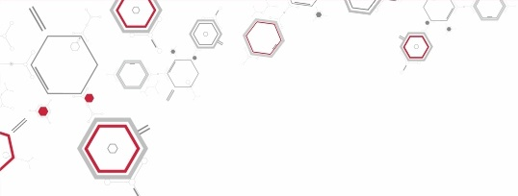
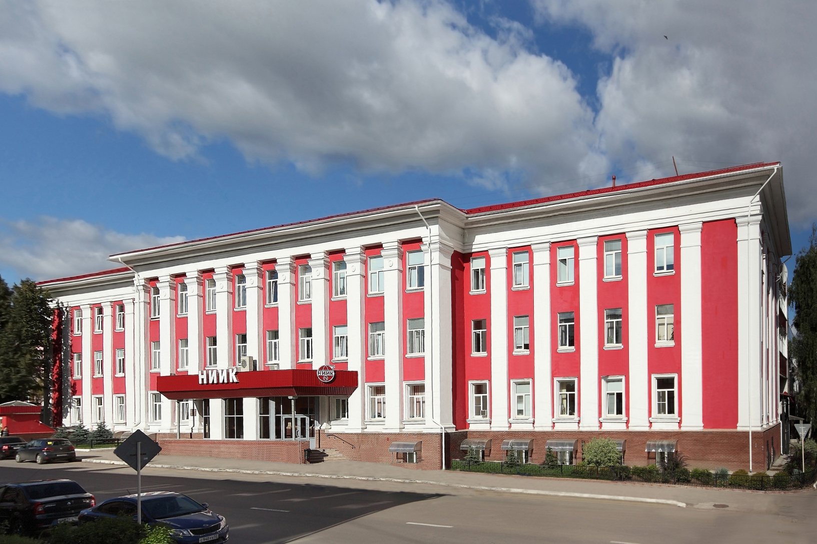
Why partner with NIIK?

Slide 2
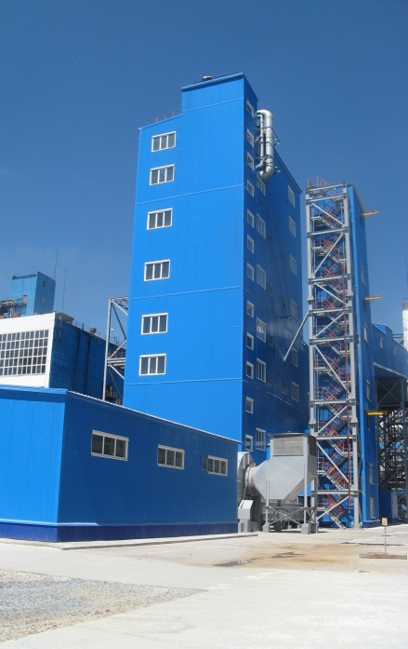
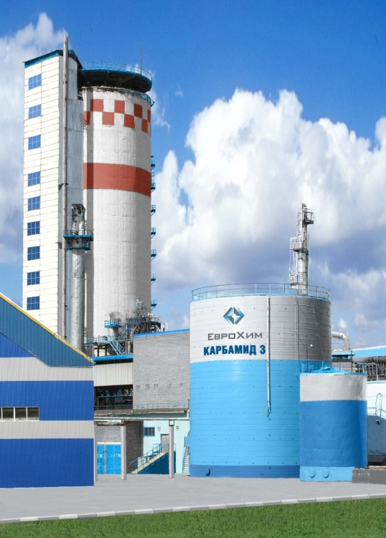
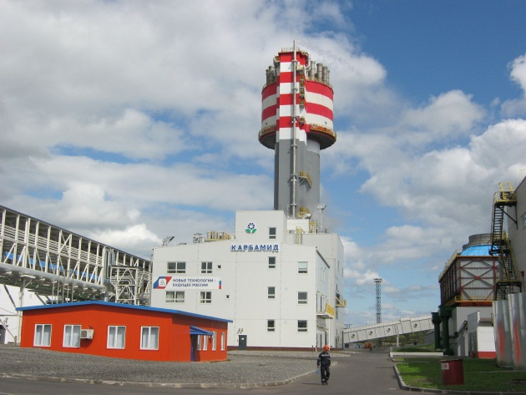
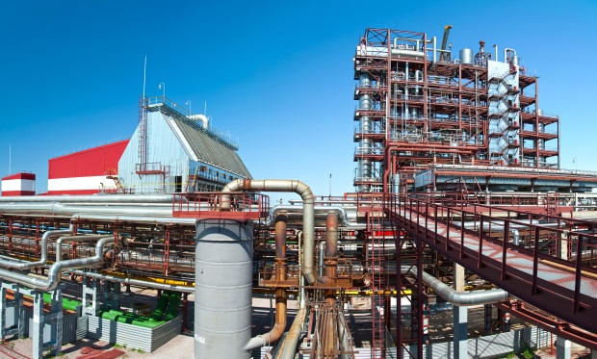
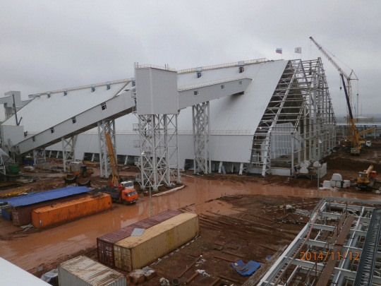
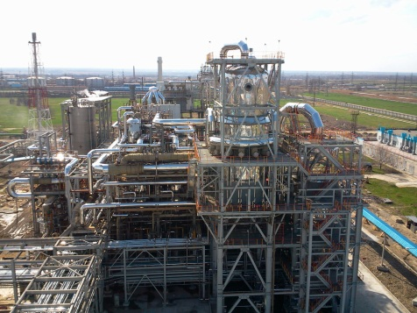
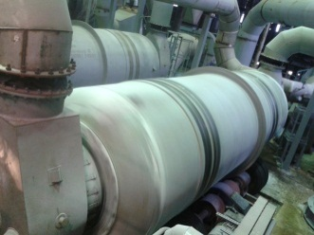
NIIK remains a leader in a national engineering sector
More than 60 years of experience in mineral fertilizers market
More than 150 production units already built
More than 500 inventions
Company' s annual turnover – RUB 3 billion (for 2013)

Slide 3
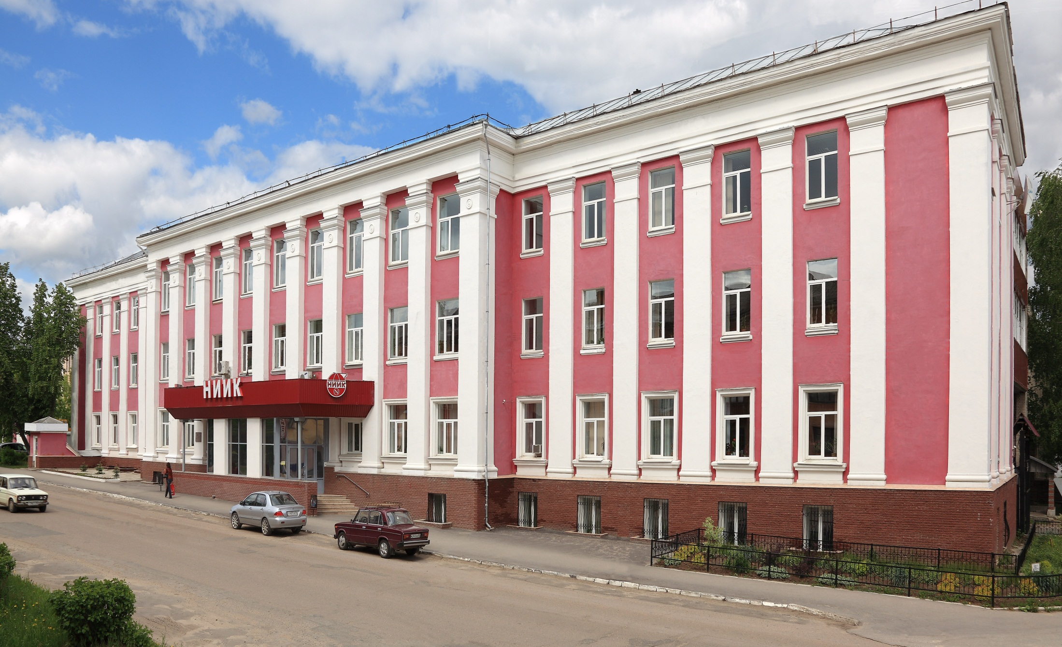
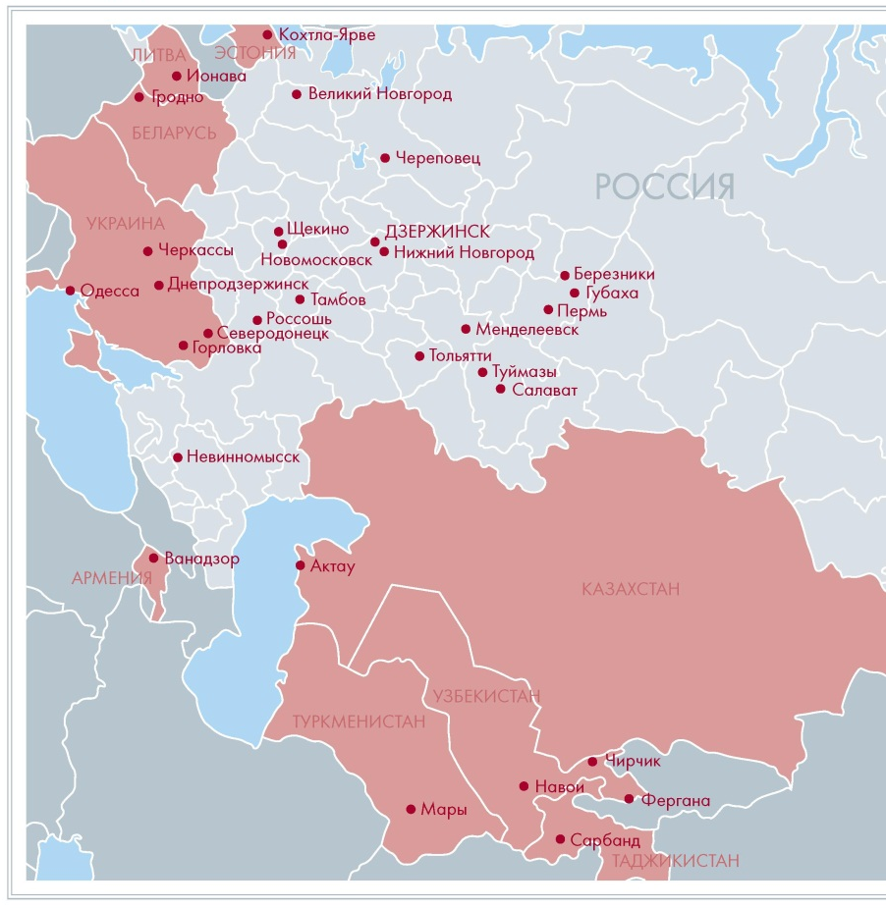
OUR CUSTOMERS AND PARTNERS

Slide 4
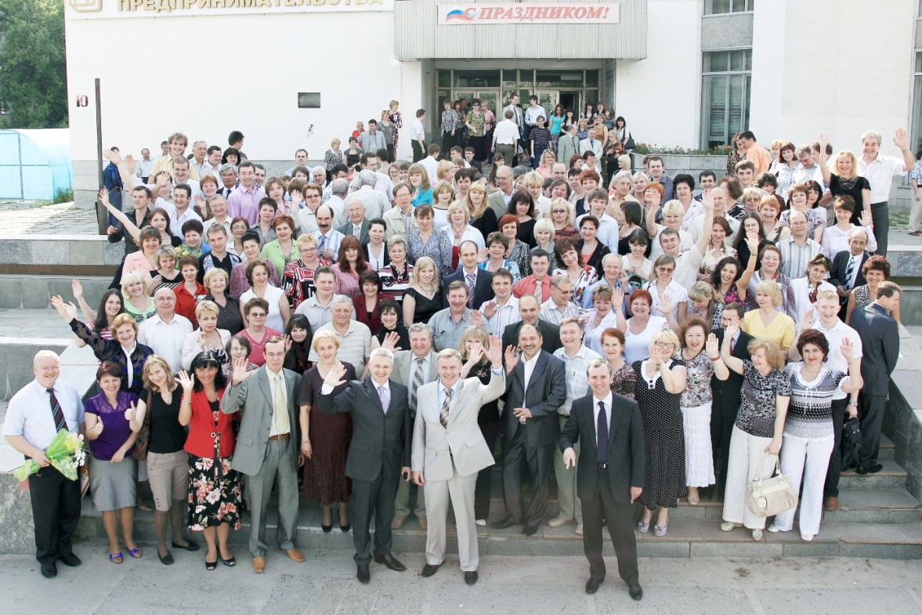
Human resources
Company personnel ~600 specialists
personnel qualification
qualification required for members of self-regulatory organizations
necessary trainings to gain additional experience
technical knowledge and skills training

Slide 5
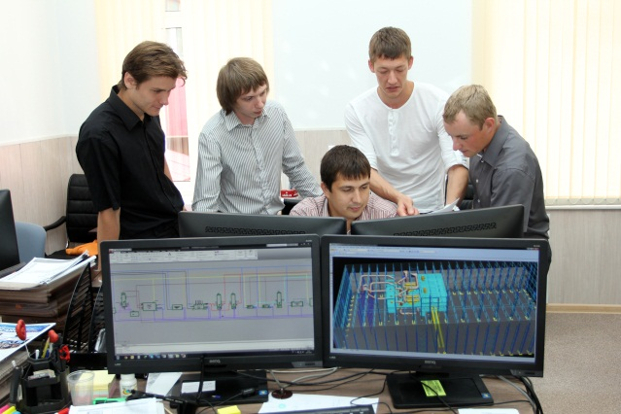
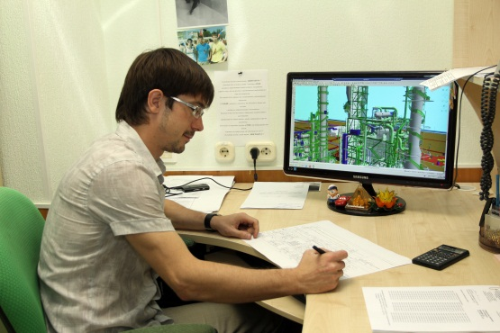
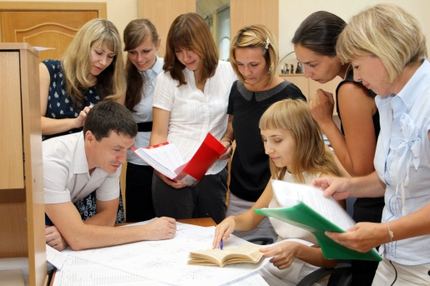
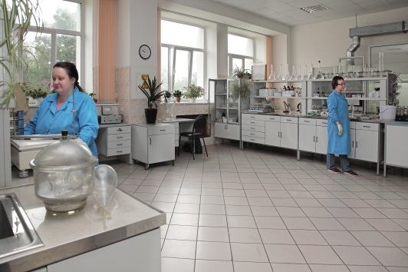
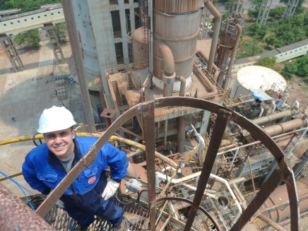
We offer our clients the full range of services
Technology development
Project engineering
Packaged delivery of equipment
DCS, simulators
Industrial safety assessment and diagnostic
Test center
Project management
Capital construction
NIIK includes departments covering engineering, technological and project management fields.
Technology and process department – is responsible for developing ideas and technologies, know-hows, equipment design etc
Design and engineering department – is responsible for project management and design documentation development
Procurement and turn- key projects- is responsible for procurement of materials and equipment

Slide 6
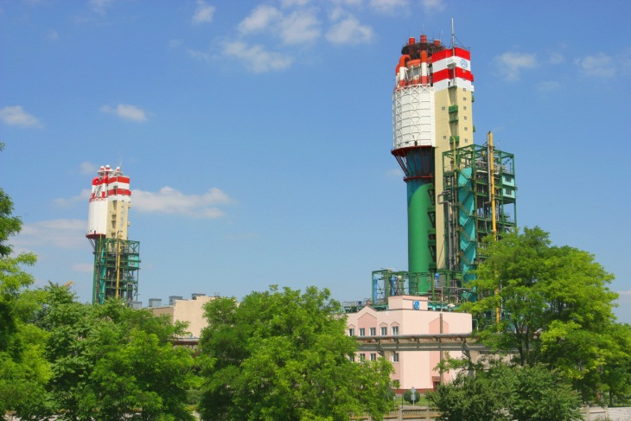
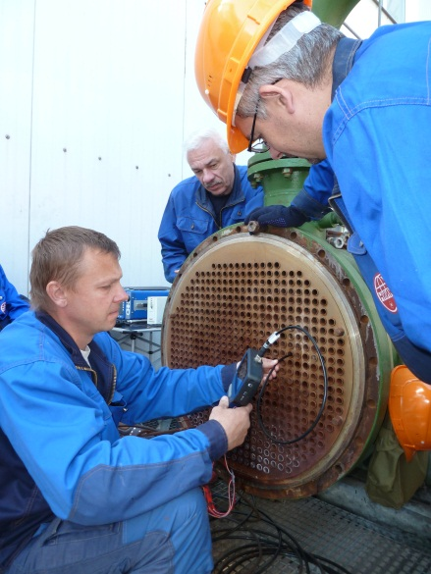
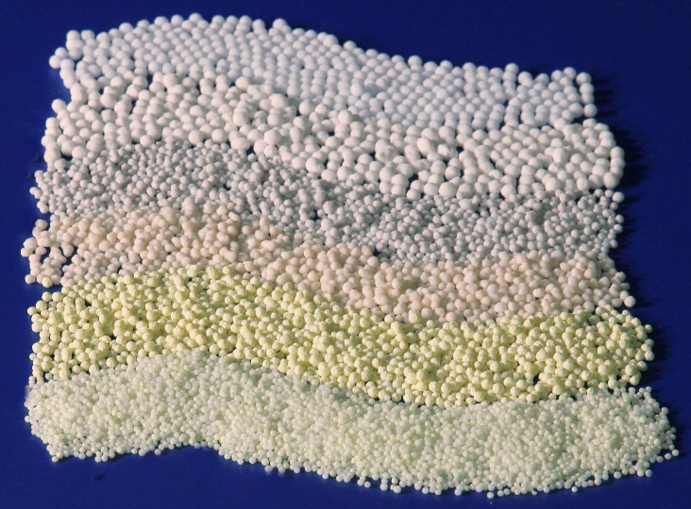
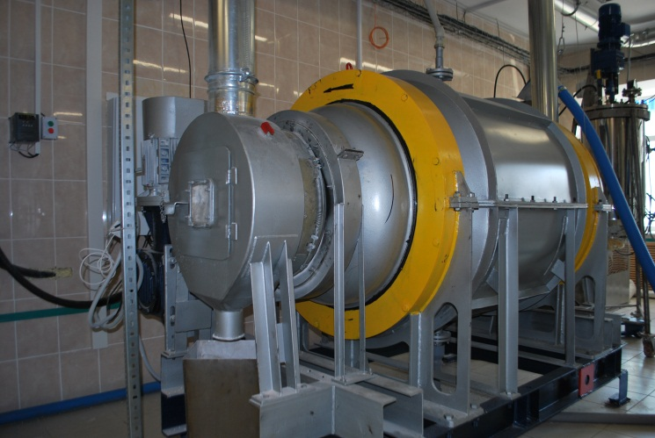
Our patented technologies
uREA TECHNOLOGIES
MELAMINE TECHNOLOGIES
new types of fertilizers
advanced repair methodologies
eco friendly technologies, benefiting
the earth

Slide 7
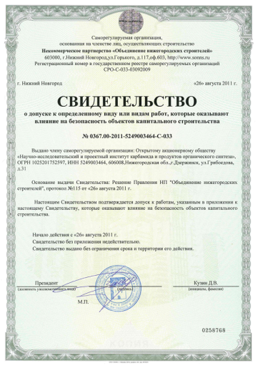
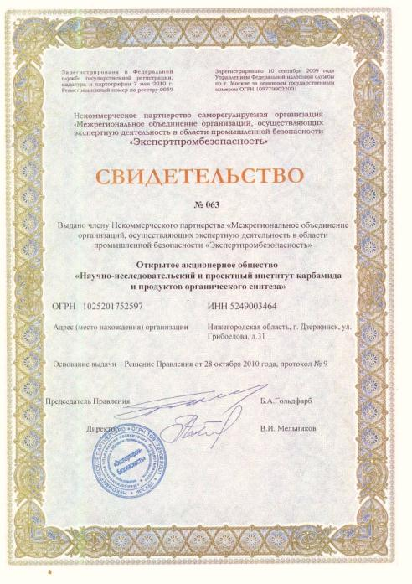
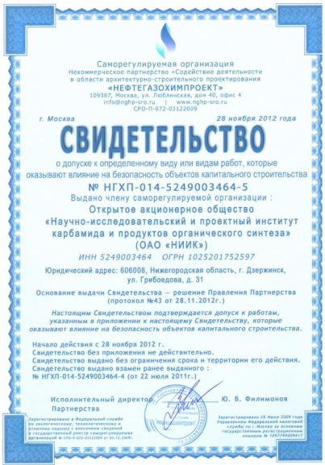
authorizations and Approvals Required for designing, construction and expert examination of industrial safety
NIIK is a member of:
Self-regulatory non-profit organization
«Neftegazohimproekt»
Self-regulatory non-profit organization
«Nizhny Novgorod builders Association»
Self-regulatory non-profit organization «Expertprombezopasnost»

Slide 8
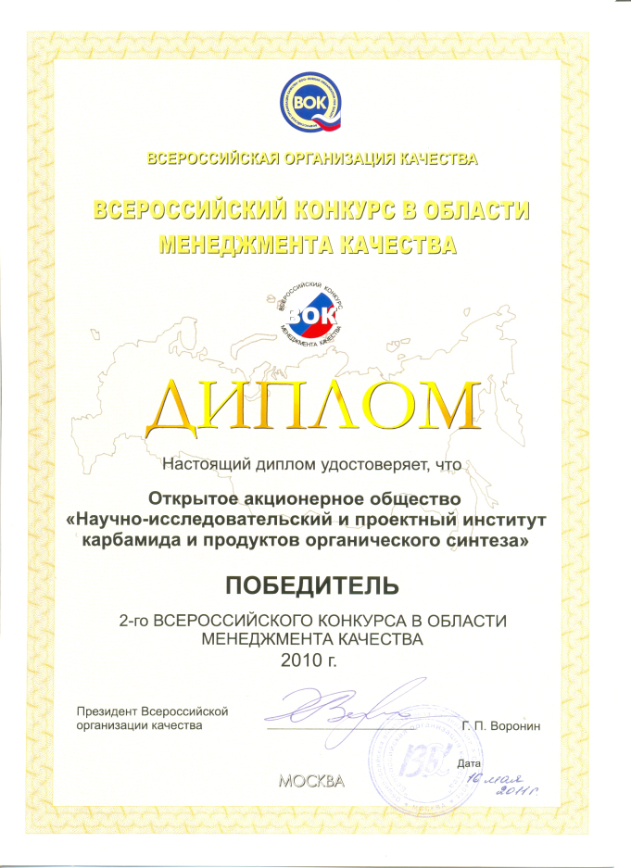
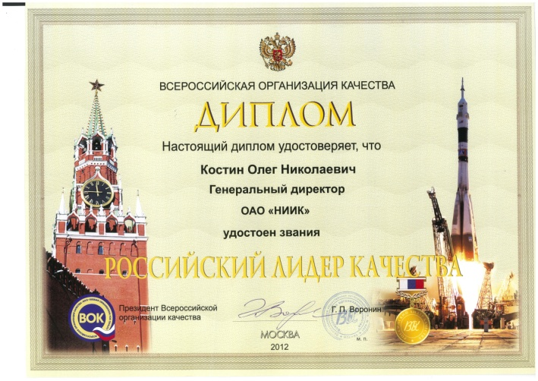
Russian Leader Of Quality
2010 – NIIK has become a winner of the Second Annual National Competition in the field of quality management.
2012 – General Director of NIIK Mr Oleg Kostin was awarded the title of Russian Leader of Quality
NIIK gained chartered status from Chartered Quality Institute, a grade of CQI membership is held by General Director Mr Oleg Kostin.

Slide 9
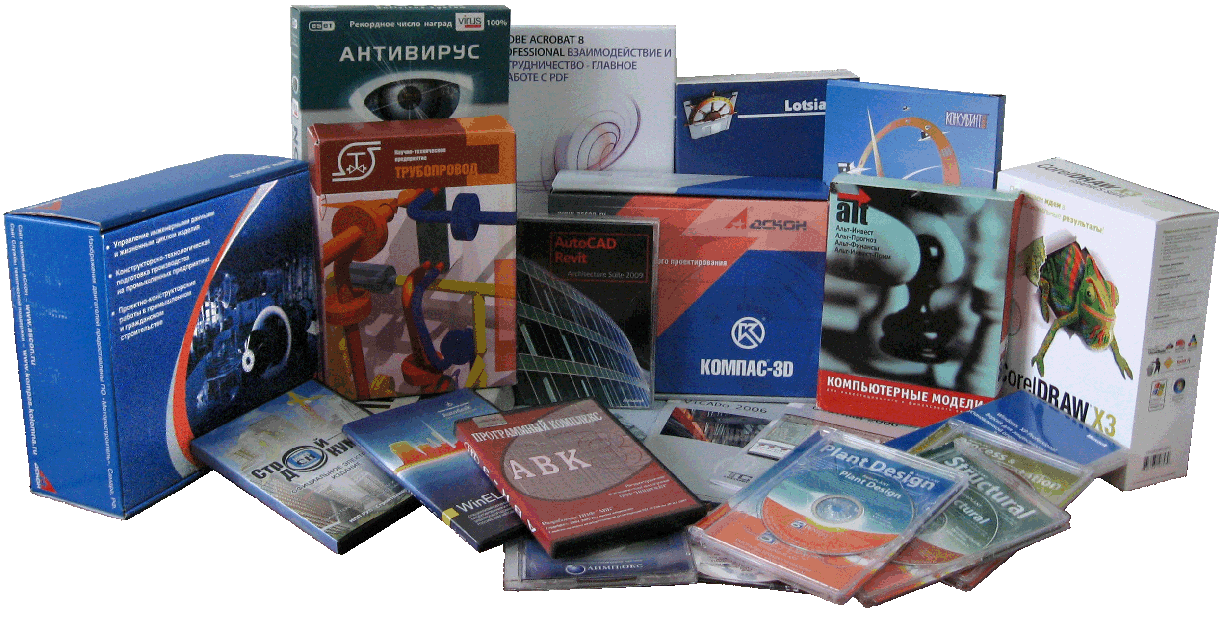
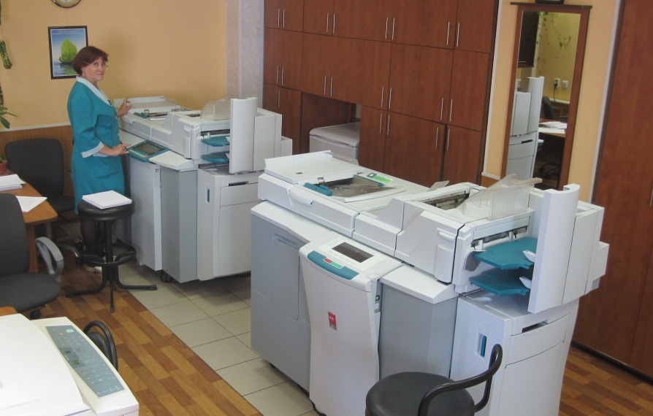
Licensed up-to-date soft wear for design,
engineering and scientific research
Office system - more than 260 licenses
CAD system – more than 128 licenses
AVEVA complex for 3D design – more than 30 workstations
Сalculation programmes– more than 60 licenses
Every work station is equipped with modern tools meeting all necessary requirements for engineering and research working environment.

Slide 10
Project management on EPC basis.
Engineering
Construction
Commissioning
Procurement

Slide 11
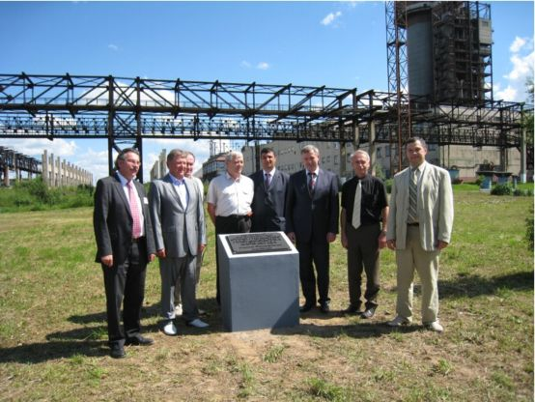
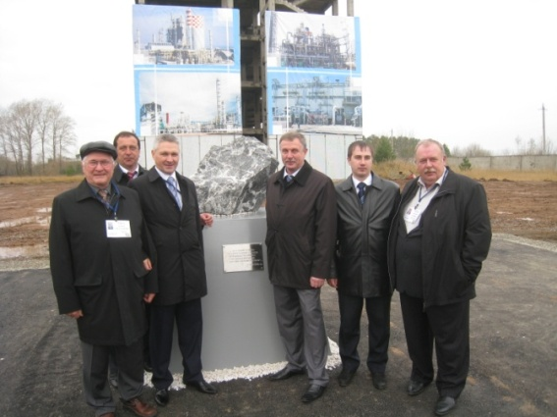
NIIK‘s experience in projects
based on foreign licensors technology
1. «Cherepovetsky Azot» (Cherepovets, Russia)
Urea capacity - 1500 TPD.
In cooperation with Chemoproject (Czech Republic).
2. «NevAzot» (Nevinnomyssk, Russia)
Melamine capacity 50 000 TPD.
In cooperation with «Lurgi» (Germany).
3. «Аmmoni» (Mendeleevsk, Tatarstan)
Chemical complex Methanol/Ammonia/Urea,
NIIK as EPC contractor
4. «Eurochem» (Novomoskovsk, Russia)
Revamping of urea unit in cooperation with «Urea Casale».
5. «Azot» (Cherkassy, Ukraine)
Revamping of urea unit in cooperation with «Urea Casale».
6. «Gasprom Neftehim Salavat» (Salavat, Russia) Urea granulation unit (capacity 1400 TPD) In cooperation with «TEC» (Japan)
7. «ShchekinoAzot» (Shchekino, Russia) Hydrogen unit construction based on Haldor Topsoe authority package.
8. «Korund-Cyan» (Dzerzhinsk)
Sodium Cyanide production unit engineering based on EPC company basic design
Cherepovets
Mendeleevsk

Slide 12
NIIK is involved in design and construction
of new fertilizer and chemical plants
Baltic urea plant
Declaration of intention development
Authority package development
Ammonia-urea complex
Rossosh
Investment feasibility studies
Consultation services when selecting contractors
Gas chemical complex
«National Chemical Group»
Declaration on investment intentions development
Preliminary environmental impact assessment development
Ammonia plant
FosAgro Cherepovets
FEED stage support
Expertise support
Assisting contractors (potential bidders) in the bidding process.
Eurochem
(ammonia Kingisepp plant/
Ammonia\urea complex Nevinnomyssk)
Field supervision
Expertise support
Detail design for construction
Authority package development
Supervision services in engineering works

Slide 13
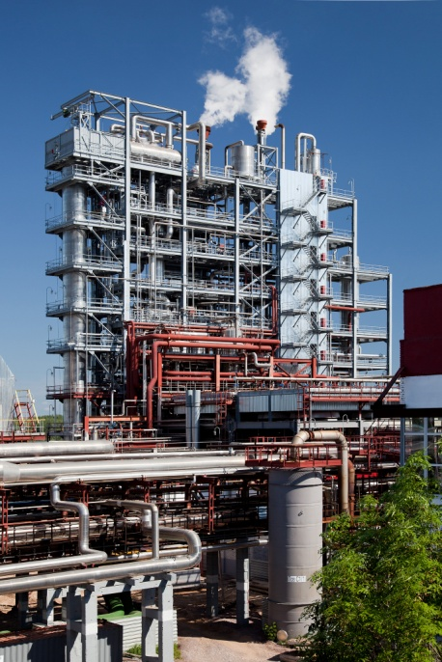
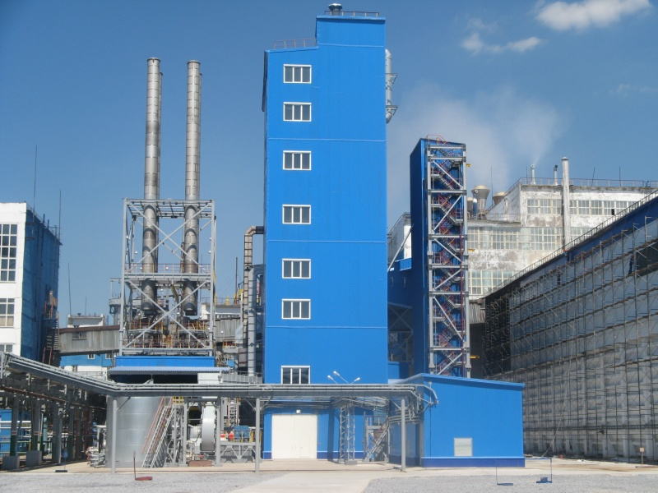
PARTNER WITH US THEREFORE
HELPING YOUR BUSINESS GROW
«ЕuroChem»
«Uralchem»
«Gasprom neftekhim salavat»
«Phosagro»
«Acron»
«ostchem Ukraine» etc
Mitsubishi Heavy Industries
Toyo
Linde
Saipem
Stamicarbon
Urea CasalЕ etc

