Slide 1
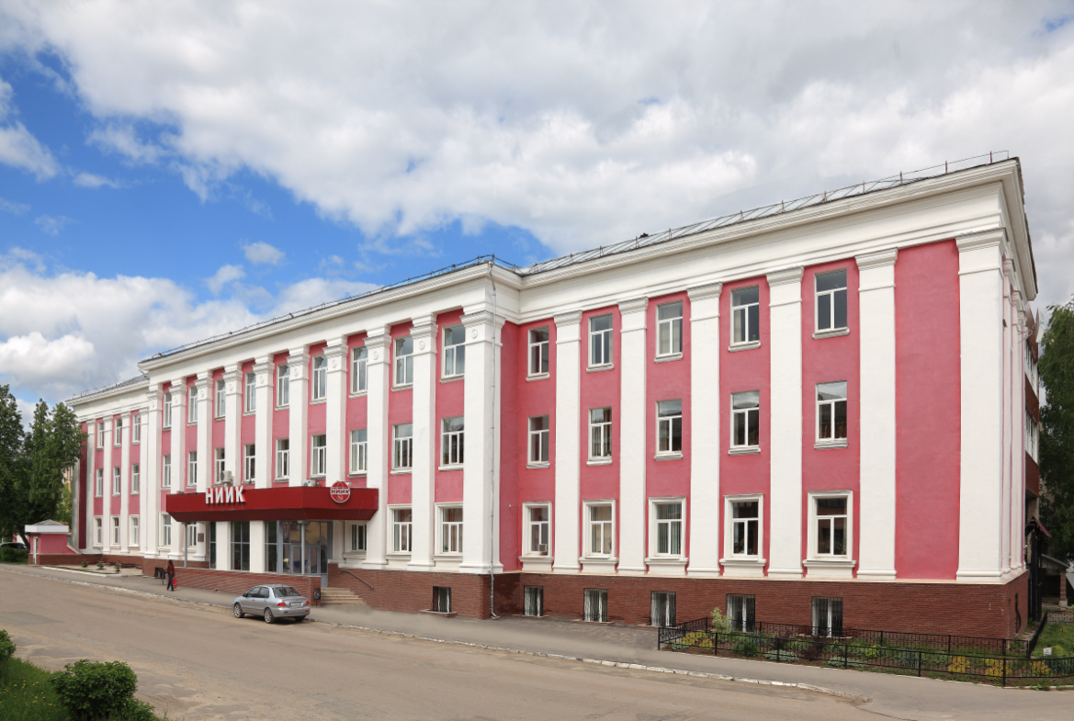
WHY NIIK IS THE BEST CHOICE
when implementing world's technologies in Russia?

Slide 2
Why NIIK is attractive for foreign licensors ?
NIIK will help:
to reduce the project implementation period
enhance the performance of investments.
to push up profit
to attract new technologies to Russia

Slide 3
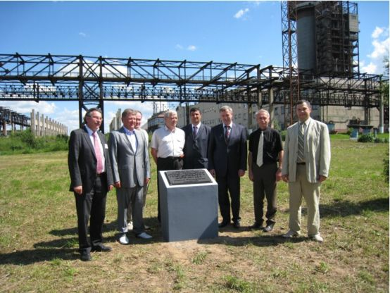
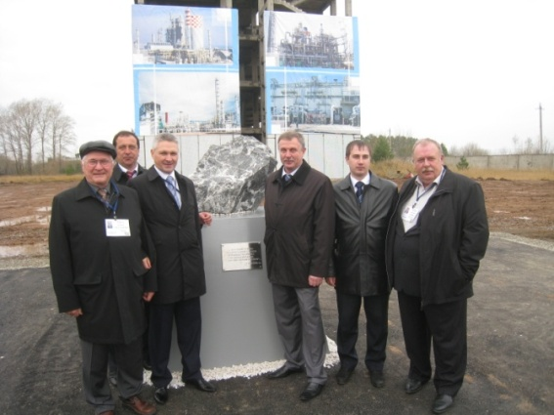
NIIK Projects based on foreign licensors technology
1. «Cherepovetsky Azot» (Cherepovets, Russia)
Urea capacity - 1500 TPD.
In cooperation with Chemoproject (Czech Republic).
2. «NevAzot» (Nevinnomyssk, Russia)
Melamine capacity 50 000 TPD.
In cooperation with «Lurgi» (Germany).
«Ammoni» (Mendeleevsk, Tatarstan)
Chemical complex Methanol/Ammonia/Urea,
NIIK as EPC contractor.
4. «Eurochem» (Novomoskovsk, Russia)
Revamping of urea unit in cooperation with «Urea Casale».
5. «Azot» (Cherkassy, Ukraine)
Revamping of urea unit in cooperation with «Urea Casale».
6. «Salavatnefteorgsintez» (Salavat, Russia) Urea granulation unit (capacity 1400 TPD) In cooperation with «TEC» (Japan)
7. «ShchekinoAzot» (Shchekino) Hydrogen unit construction based on Haldor Topsoe authority package.
8. «Korund-Cyan» (Dzerzhinsk)
Sodium Cyanide production unit engineering based on EPC company basic design
Cherepovets
Mendeleevsk

Slide 4
Advantages of cooperation between foreign licensor
and NIIK for the customer
Reduction of time and expenses for authority package development
Development of environmental protection, industrial safety and fire fighting solutions
Quick approval by State Expertise Committee
Control for documentation adaptation to Russian regulations at early project stages
Civil design according to Russian conditions
Regional traditions for constructions and manufacturing of engineering structures are taken into account.
Foreign licensor submits:
!
License for technology
Basic engineering/basic design
Detailed engineering
Equipment procurement
At the battery limit of equipment procurement
NO authority package
Customer requests for:
Engineering and design, integration with the infrastructure
Documentation for approval
Building permit
Detail design for construction
Compliance of import deliveries with Russian safety codes

Slide 5
What prevents foreign licensor from development of authority package on their own?
Bad knowledge of Russian norms and regulations
Peculiarities of authority package sections

Slide 6
design Documentation developed by NIIK based on FEED-package provided by foreign Licensor
AUTHORITY PACKAGE
50%
DETAILED ENGINEERING
50%
Basic engineering (25-40%)
Process solutions,
process control
Inclusive of consulting services for adaptation to Russian safety regulations (5%)
Main sections (50-65%)
Architectural, civil, construction and others (50%)
Additional sections (10%)
Contract supervision (3-5% of design documentation)

Slide 7
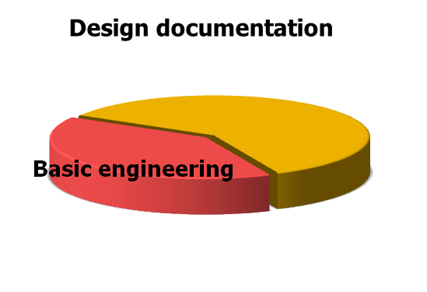
Authority package development
Basic engineering
Authority package
Plot plan (building arrangements, sites, pavements)
Plot plan; vertical leveling; earthworks table; site map etc
Architectural and civil solutions
Architectural and civil solutions; design and planning solutions; development of engineering structural drawings
Utilities
Utilities;
Design of energy supply systems
Process solutions
- Environmental protection
- Reducing negative environmental impact
Process solutions
Construction arrangement draft
Fire fighting system
Civil defense and industrial safety

Slide 8
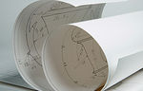
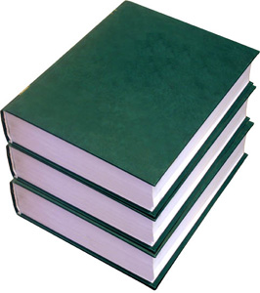
Licensor´s Involvement in authority package development
To submit additional information
To perform and submit calculations and drawings required for design documentation development
To adapt design documentation to Russian norms and regulations, inclusive of revision of the documentation in accordance with State Expertise Committee´s comments and wishes

Slide 9
Questions which may arise during DETAILED design documentation development
Differences in construction norms
Construction softwear should be certified by Rostehnadzor
Need in Russian engineering company for detailed engineering development
Separate sections of detailed design documentation should be approved by State Expertise Committee

Slide 10
NIIK´s services for foreign licensor´s technology adaptation
Design of warehouses and buildings
Consulting services
Project Integration Management - integration with the site infrastructure
Assistance in bidding (technical services)
Project development and implementation
Detail engineering
Development of technical annexes to contracts
Authority package
Adaptation of basic engineering to Russian norms and regulations

Slide 11
The Basics of Success when implementing project in Russia
Involvement of a Russian engineering company (for authority package development, for process selection)
Foreign licensor's technology adaptation to Russian legislation (at all stages of the project cycle)
Common project schedule for all subcontractors
Direct communication between Licensor and Russian engineering company
Efficient information exchange between Licensor and Russian engineering company

